Slide 1

Microeconomic Tools to Create a Greener Economy

Slide 2

Microeconomics- Definition from Investopia
“Microeconomics is the social science that studies the implications of incentives and decisions, specifically about how those affect the utilization and distribution of resources. Microeconomics shows how and why different goods have different values, how individuals and businesses conduct and benefit from efficient production and exchange, and how individuals best coordinate and cooperate with one another.
https://www.investopedia.com/terms/m/microeconomics.asp

Slide 3

Microeconomic Tools (Potential Policies)
Microeconomic policy is involved with the specific ways in which businesses and consumers interact, and frequently takes the form of incentives (carrots) or penalties (sticks) on certain types of economic behavior, intended to bring about economic or political goals¹.
The Carrot and Stick approach of motivation is based on the principles of reinforcement first espoused by the philosopher Jeremy Bentham (1748-1832).
1. http://www.businessdictionary.com/definition/microeconomic-policy.html

Slide 4
What are Microeconomic Tools that the Federal Government could use to Decarbonize the Energy Sector?

Slide 5
Some Important Sticks to Change up Incentives in the Marketplace
A Carbon Tax: A carbon tax is a type of Pigouvian tax like a sin tax (alcohol and cigarettes) or a pollution tax (heavily used by Germany to pay for their reunification costs).
Cap and Trade
Command and Control – The Clean Air Act is an example of command and control regulation.
Setting efficiency standards for things like cars and major appliances like HVAC systems and refrigerators.

Slide 6

Carbon Tax: Two Competing Design Ideas
The tax can be revenue neutral. (Attempt in the State of Washington)
or
II) Revenue for the government that can be invested in the energy transition. Here are a few ways this revenue could be invested:
Helping low-income people reduce their energy expenses by actions like making their homes more energy efficient.
Investing in green infrastructure like public transportation or more high voltage lines from the great plains to major load centers (places where lots of electricity is consumed).
R&D in areas where more innovation is still needed like energy storage, ships and planes that run on clean energy, ways to use clean energy to make cement and steel, etc.

Slide 7
Cap and Trade
The cap and trade tool was first use to deal with the acid precipitation issue. It was a free market approach developed (championed) by the Heritage Foundation. President George H. W. Bush was instrumental in this utilization of cap and trade in the policy area. Cap and Trade was incorporated into the Amendments to the Clean Air Act in 1990 and time has shown that this was an effective and efficient way to reduce sulfur dioxide emissions from power plants. Cap and Trade was viewed prior to 2009 as the Republican alternative to a carbon tax.

Slide 8
Regulate Carbon-Dioxide by Declaring it a Pollutant.
The Obama Administration used the power given to the Executive Branch to declare CO₂ a pollutant. This was challenged in court but the Supreme Court in a 5-4 ruling upheld this move. This became the foundation of the Clean Power Plan which President Trump has gutted. This is an example of the command and control approach. It is less efficient than a carbon tax or cap and trade, but it was the ONLY option open to President Obama because Congress would not pass a climate plan.

Slide 9
Regulate the Grid and Require more Carbon Free Energy
An example of this are Renewable Energy Portfolio Standards (REPS). Twenty-nine states and the District of Columbia have passed a REPS. North Carolina has one of the weakest (12.5% by 2021) but it is the only state besides Virginia in the region with a REPS. 14 states—California, Colorado, Hawaii, Maine, Maryland, Massachusetts, Nevada, New Mexico, New Jersey, New York, Oregon, Vermont, Virginia, Washington, as well as Washington, D.C. Puerto Rico and the Virgin Islands—have requirements of 50% or greater and Hawaii and California have REPS that aim for 100% renewable energy by 2045.

Slide 10
Efficiency Standards
Set standards for vehicle efficiency – Example- Congress created Corporate Average Fuel Efficiency (CAFÉ) standard with the Energy Policy and Conservation Act of 1975. This is a power mostly reserved for the federal government but when the standard was established in 1975 California was grandfathered in and allowed to establish stricter standards.
Federal and local government can set efficiency standards for public buildings. In the past we never took a life cycle perspective but instead used a lowest bid perspective. Given the life span of public building it is important to consider the long-term costs to taxpayers of operating that building along with its environmental impact.
The Federal Government could also set standards for buildings in the private sector and this is done by some states. California with it Zero Net Energy Buildings Plan is the most notable example.
The Federal Government and California have set standards for major energy using appliances like HVAC systems and refrigerators.

Slide 11
Some Important Carrots to use in Altering the Energy Landscape
Subsidies
Accelerate the Speed of Innovation
Procurement policies
Deregulation of the Energy Sector
From the movie the Martian- Mark Watney (lead character): “In the face of overwhelming odds, I'm left with only one option, I'm gonna have to science the shit out of this.”

Slide 12
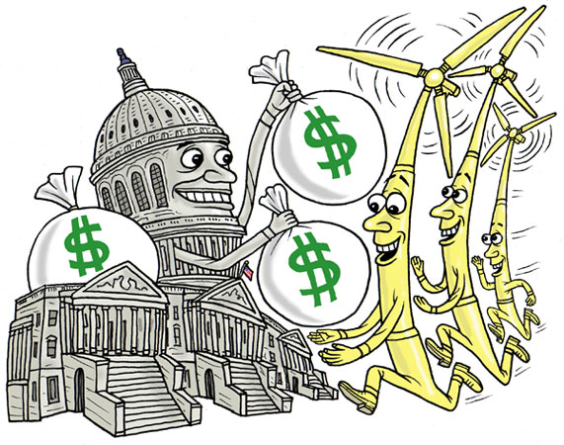
Subsidies
Advantages and disadvantages of subsidies
Examples of subsidies
tax credits to enable new industries or encourage early adopters
Feed-in- tarrifs
R&D expenditures
Direct investment in new companies in desired niches with loans or grants

Slide 13
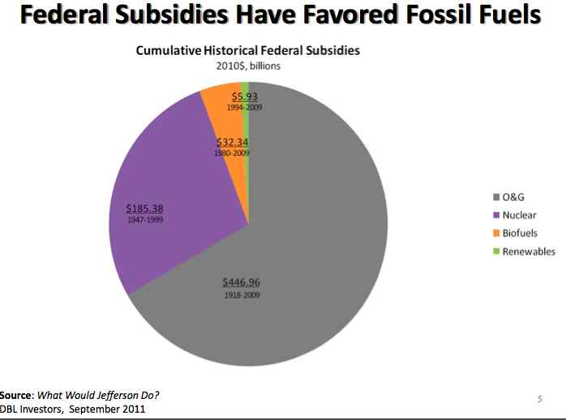
US Historical Subsides in the Energy Space demonstrate the potential perils of subsidies.

Slide 14
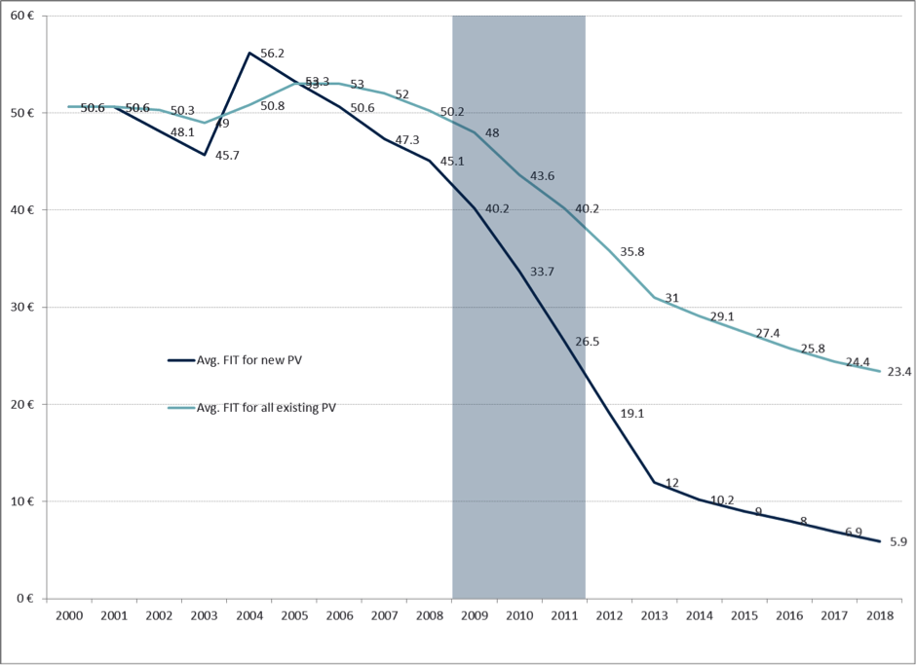
The German Feed-in-Tarrif (FIT) is an example of a smart subsidy: Note the Built in Decline of the FIT

Slide 15
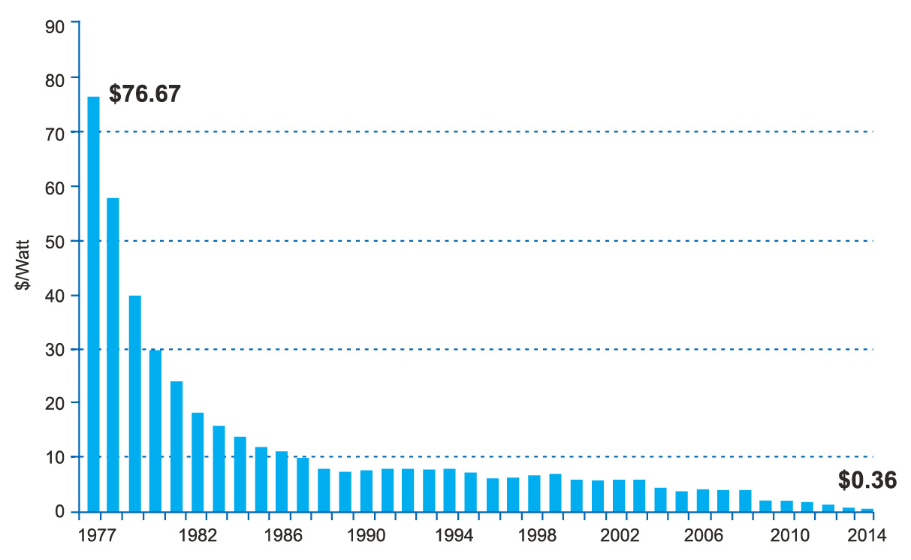
The Development of the German FIT played a major role in these Price Declines
Notes:
Price history of silicon PV cells in US$ per watt (Source: Bloomberg, New Energy Finance pv.energytrend.com)

Slide 16
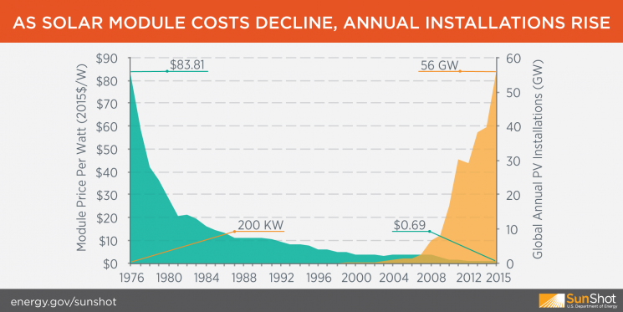
Market Forces driving the rise of Solar
https://www.climatesolutions.org/bright-future/clean-energy-economy/1476391533-economics-solar-energy-growth

Slide 17
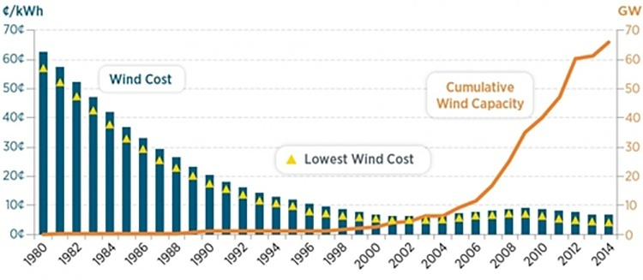
Falling prices also pushing the wind industry forward-FITS and tax credits played a critical role in this process.
Source: https://www.transcend.org/tms/2015/12/renewable-energy-soars-in-2015/

Slide 18
Accelerating the Speed of Innovation
Government subsides for research and development and the case for government to play a big role in R&D
Tax incentives for greater private sector R&D
Money for public private partnerships
Investment in focused research institutions (Ex. National Institute of Health)
Creating incentives for more collaboration between universities and the private sector
Support for small businesses and start-up (everything from financial help to the creation of more incubator space)
Industrial Policy

Slide 19
Procurement Policies
Governments have enormous purchasing power and can help new technologies scale up faster. As an example, a policy could require all Federal Buildings to have battery powered microgrids to keep them up running when the grid goes down. This would be a huge boost to companies in the energy storage and microgrid space and contribute to the movement towards zero net energy building. An additional benefit of such a policy would be to boost the resiliency of our cities because different microgrids can be islanded or also connected to other microgrids to help power a city when the grid is down.

Slide 20
Deregulation of the Energy Sector
Given already where the prices for renewable energy are already and where they are going, a deregulated grid like in Texas, will see for a faster adoption of renewable energy than a regulated market like South Carolina that lacks a REPS or like North Carolina that has a weak REP.

Slide 21

Questions for Class Discussion
Be prepared to discuss in a group and then report back to the class: “The best strategies the United States can use to decarbonize its energy supply”
What is to like about Germany’s Feed-in-Tariff? The big negative is that it caused Germans to pay more for electricity. Why in your estimation would Germans not only accept this but even champion it in large numbers, but Americans would be unlikely to support such a measure?
Why should the US be examining new strategies to accelerate innovation not only in the energy space but in all areas of the economy?

